Slide 1
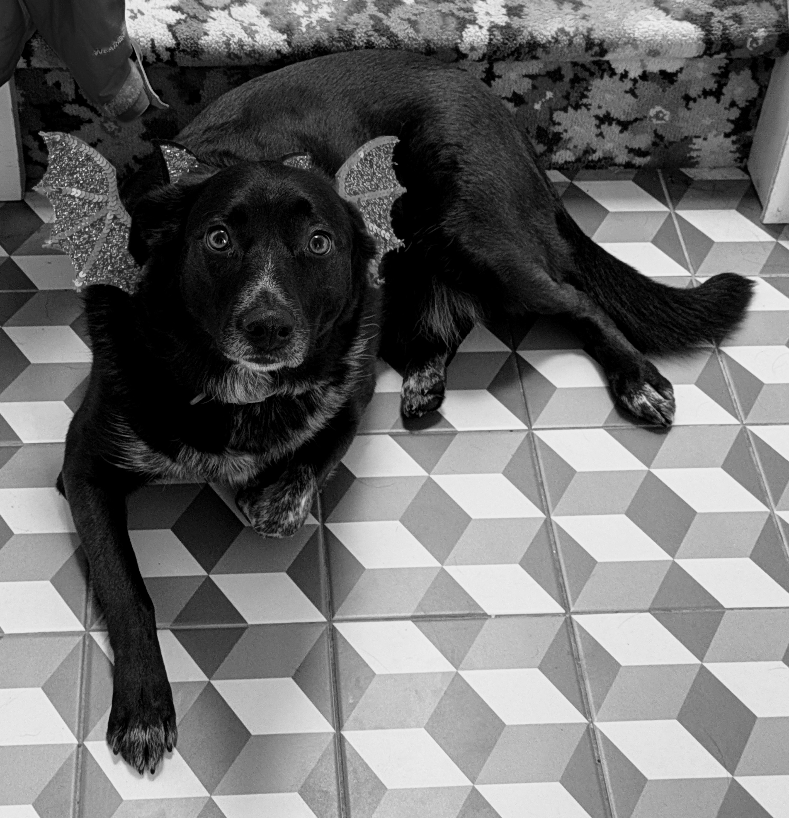
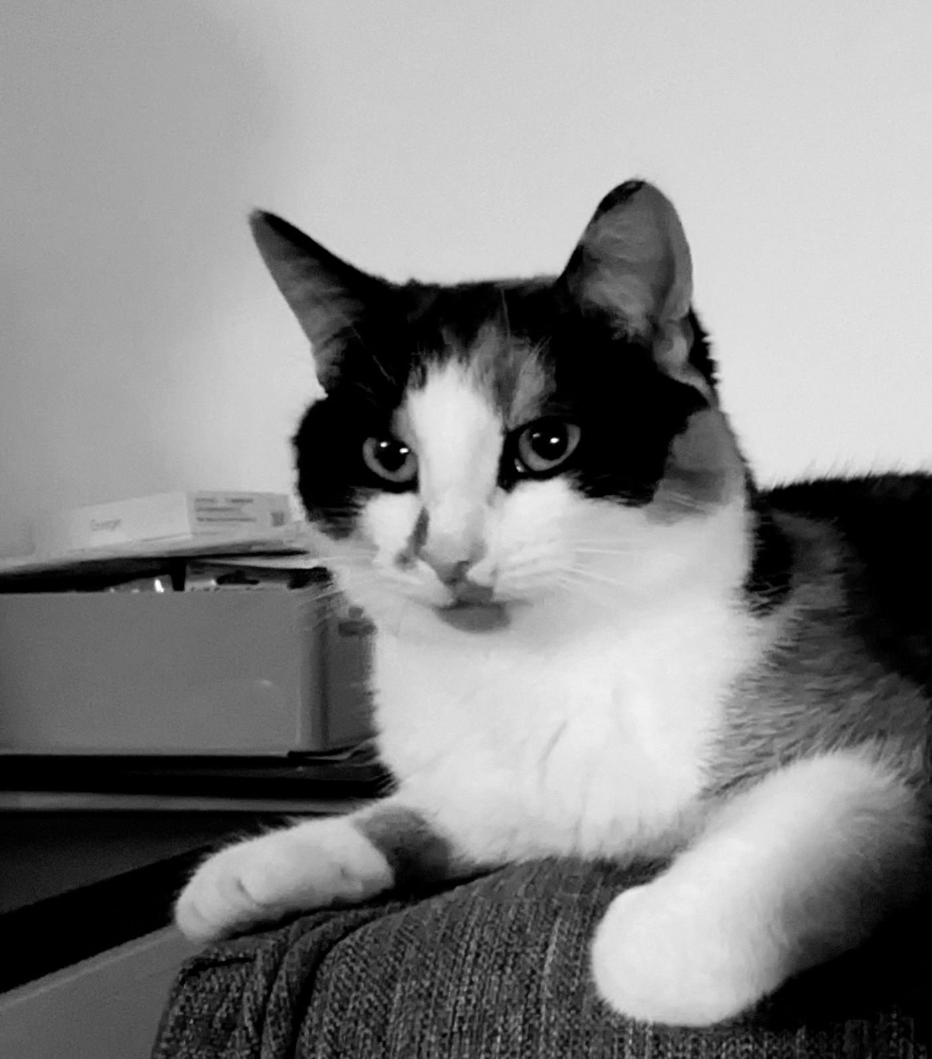



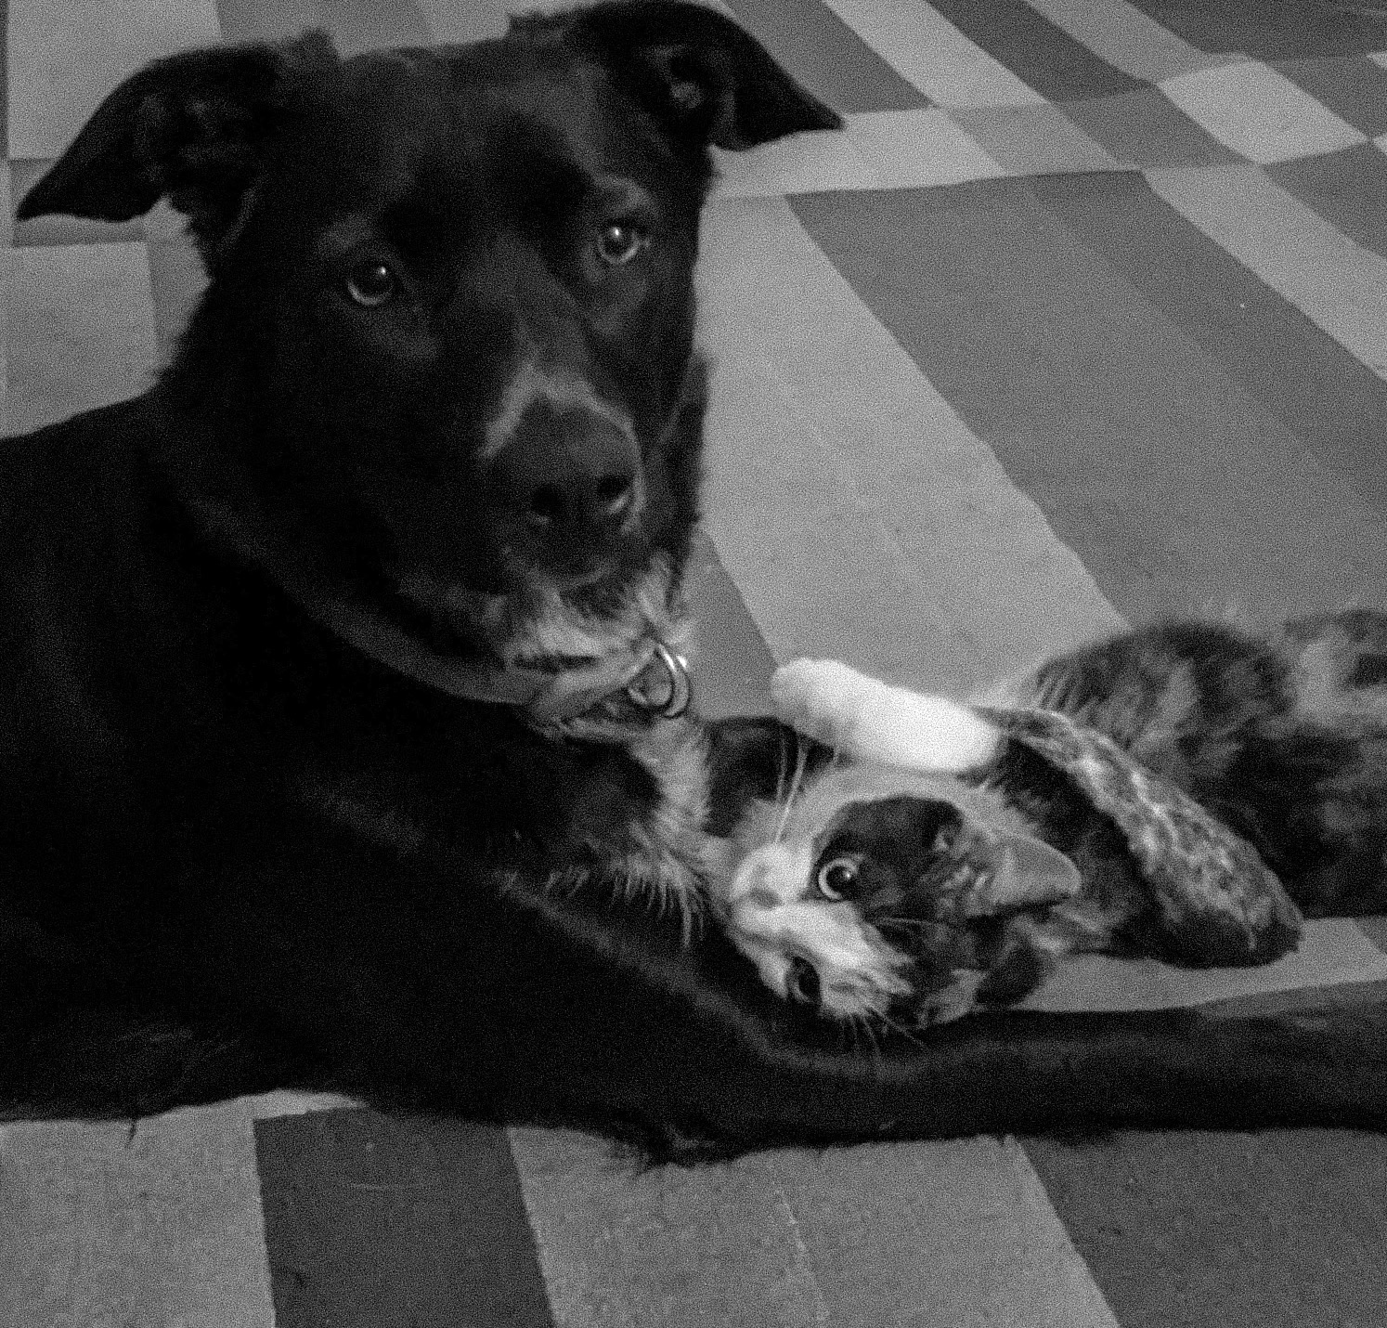
A Tail as Olde as Time
We love Berry and Sprinkles.
Sprinkles is a psychopath:
Here they are together....
Berry
&
Sprinkles
Berry
&
Sprinkles
Berry
&
Sprinkles
Berry is a dog.
Sprinkles is a cat.
Berry loves balls:

